Slide 1
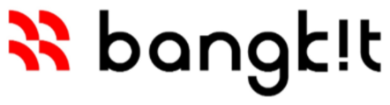
SKIN CANCER DETECTION
Go-to-Market / Sustainability Proposal

Slide 2
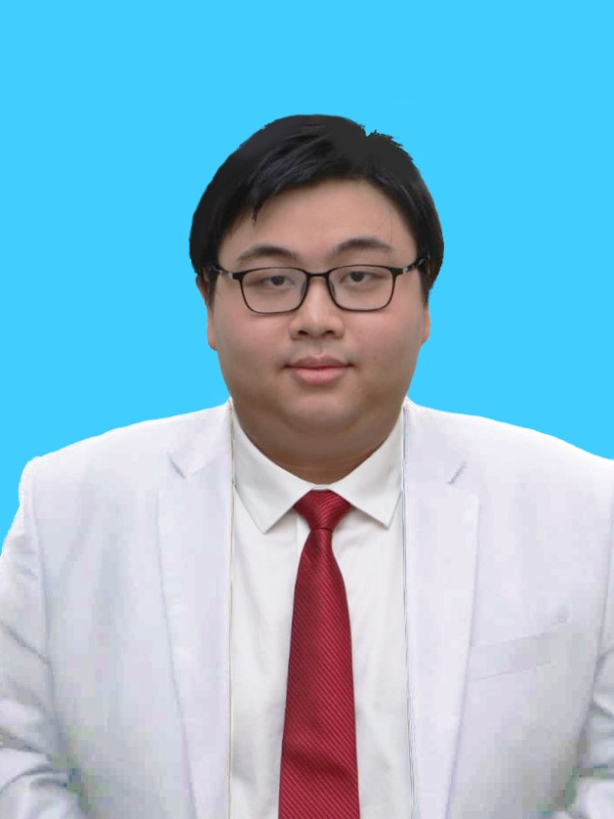
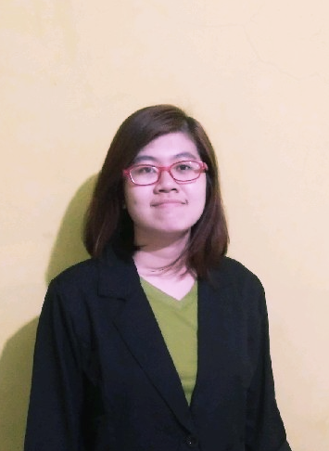

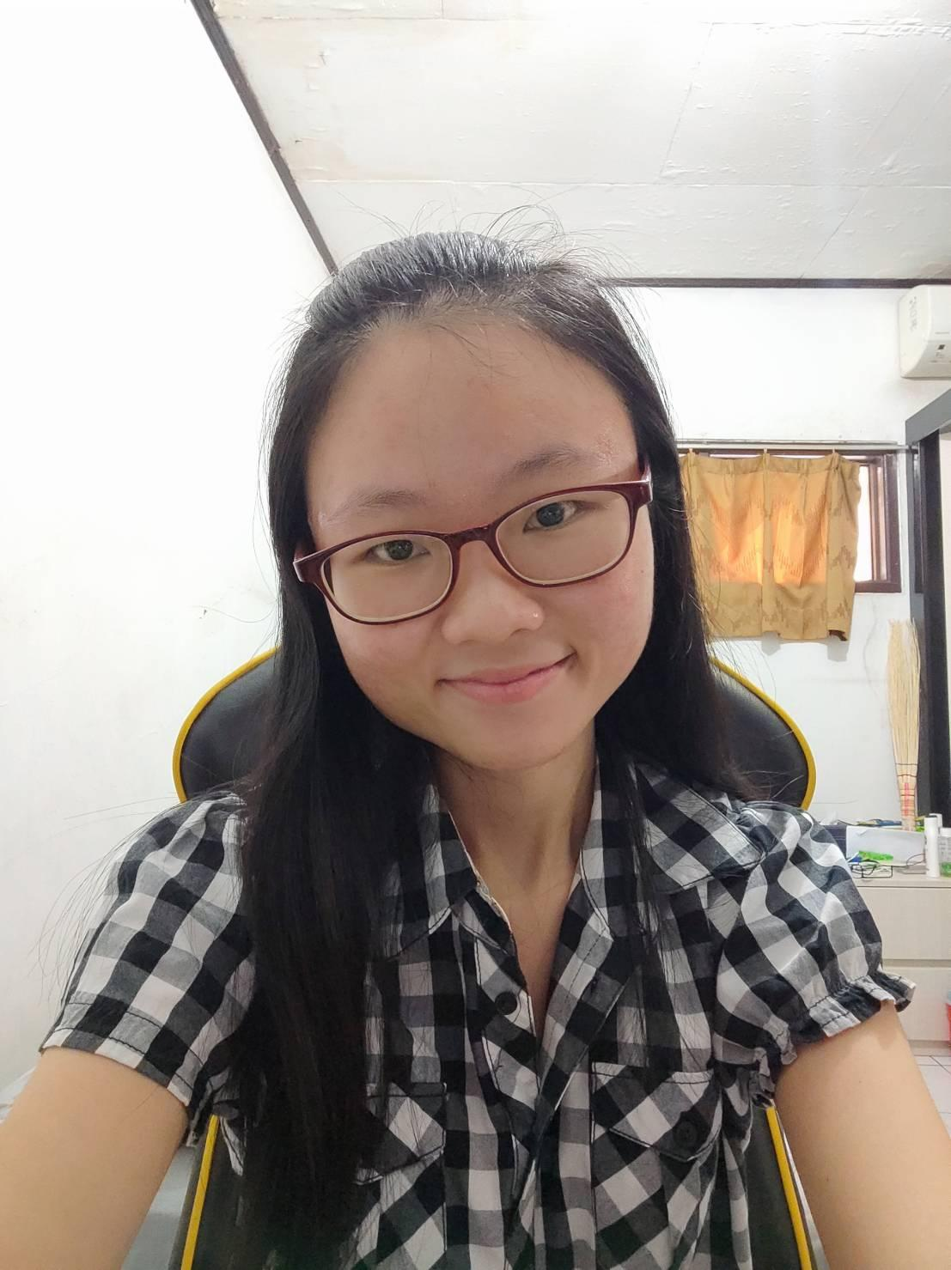
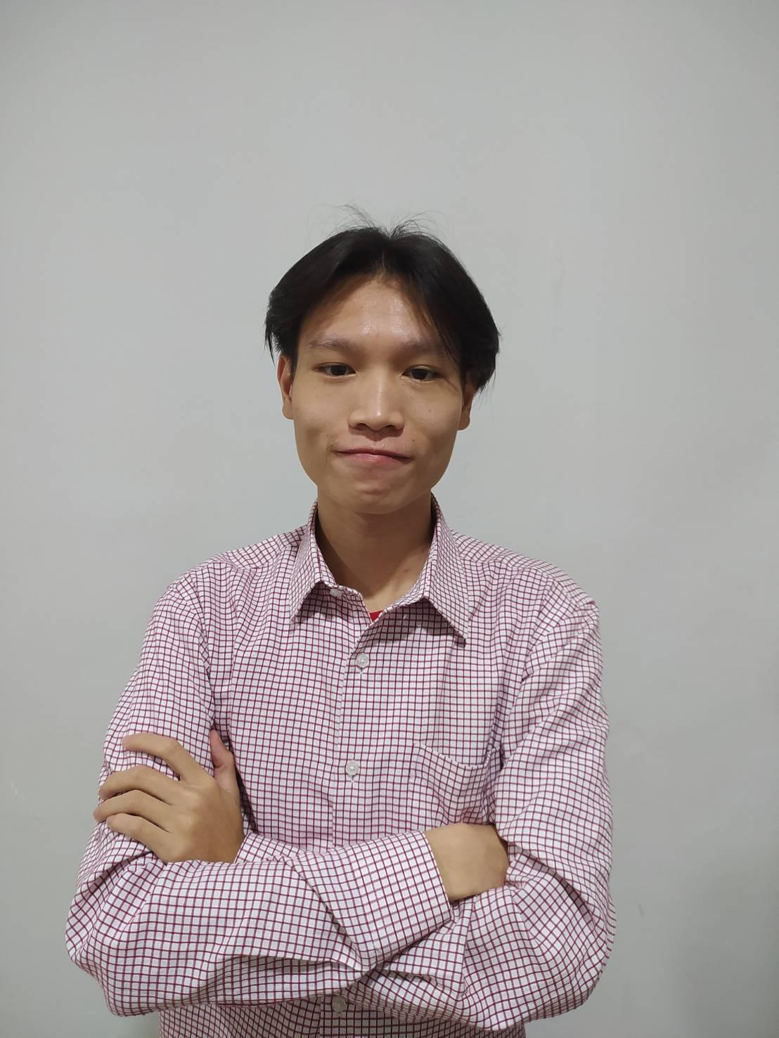
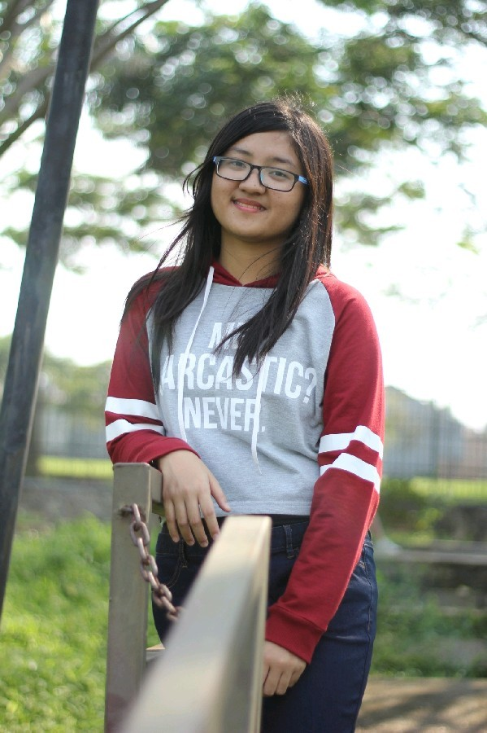
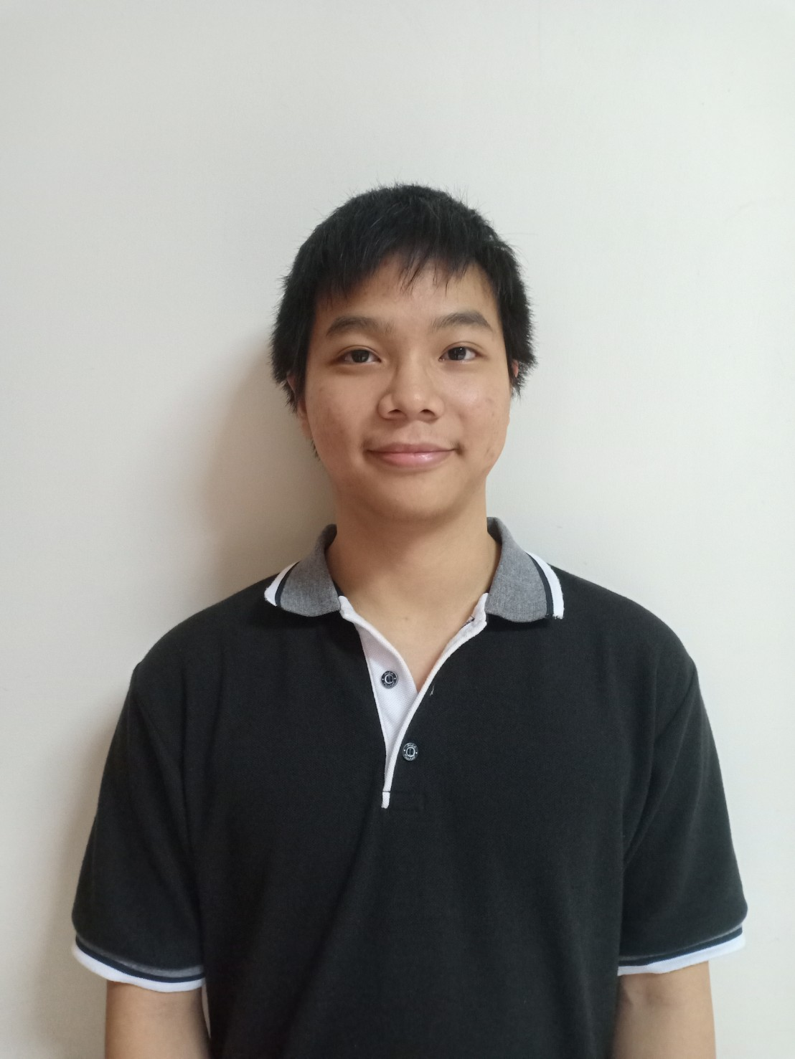
Our Team
Andreas Aditya Sumasta
Sipky Jaya Putra
Katherine Rayani
Pratama
Cynthia Caroline
Sherina Melinda
Alexander Tri Handoyo Wangsaputra

Slide 3
TABLE OF CONTENTS
01
02
03
BACKGROUND
APP PREVIEW
PERSONAS
04
05
06
TARGET MARKET
ROADMAP
BUDGETING

Slide 4
01 Background

Slide 5
Skin Cancer
Is the most common type of cancer in the world and the third most common type of cancer in Indonesia

Slide 6
What are you trying to achieve / solve?
We would like to create an application to detect those skin cancer and handle them before the cancer get worse.

Slide 7
Is there anything been done before?
Based on our current knowledge, there are some applications like this outside of Indonesia. Other than some journals, there are no real applications for this in Indonesia

Slide 8
Why your capstone project is built in the first place?
We want to detect skin cancer as it is one of the most common type of cancer and help prevent it from getting worse

Slide 9
What are the advantages of your capstone project?
We could use this application to help the public to detect an early sign of skin cancer
General Practitioners could also use it as a base to send a patient to a specialist

Slide 10
02 APP PREVIEW

Slide 11
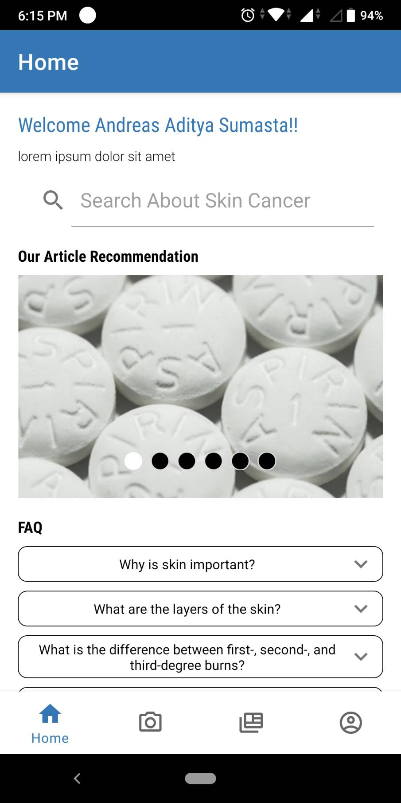
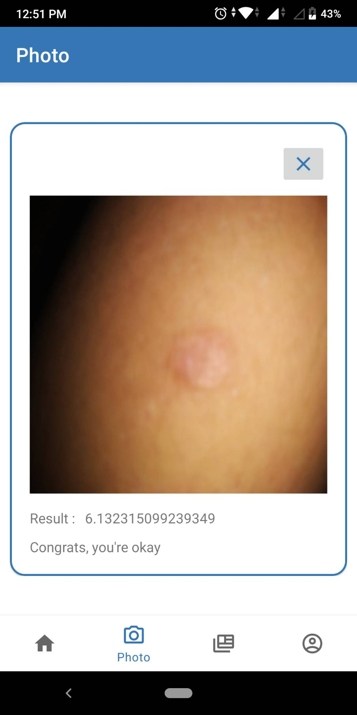
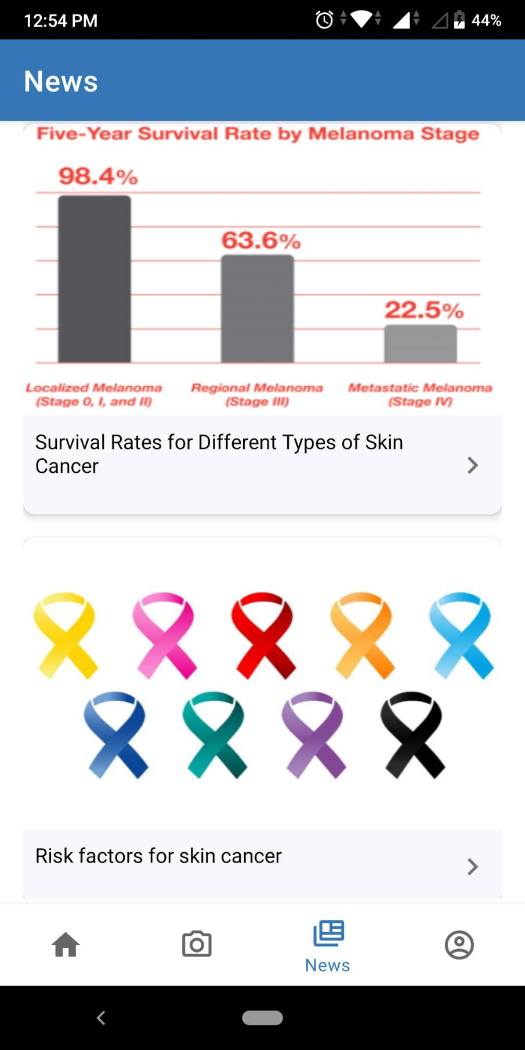
Screenshots of your app

Slide 12
03 PERSONAS

Slide 13
PERSONA
AGE
PROFESSION
ROLES
ATTRIBUTES
15 - 45 years old
people who often goes in outdoor
Public user
Adventurous people who like exploring nature and touring using motorcycle / bicycle

Slide 14
PERSONA
AGE
PROFESSION
ROLES
ATTRIBUTES
More than 25 years old
Doctor
General Practitioner
General practitioners that use this app as a first diagnosis before sending the patient to a specialist

Slide 15
04 TARGET
MARKET

Slide 16
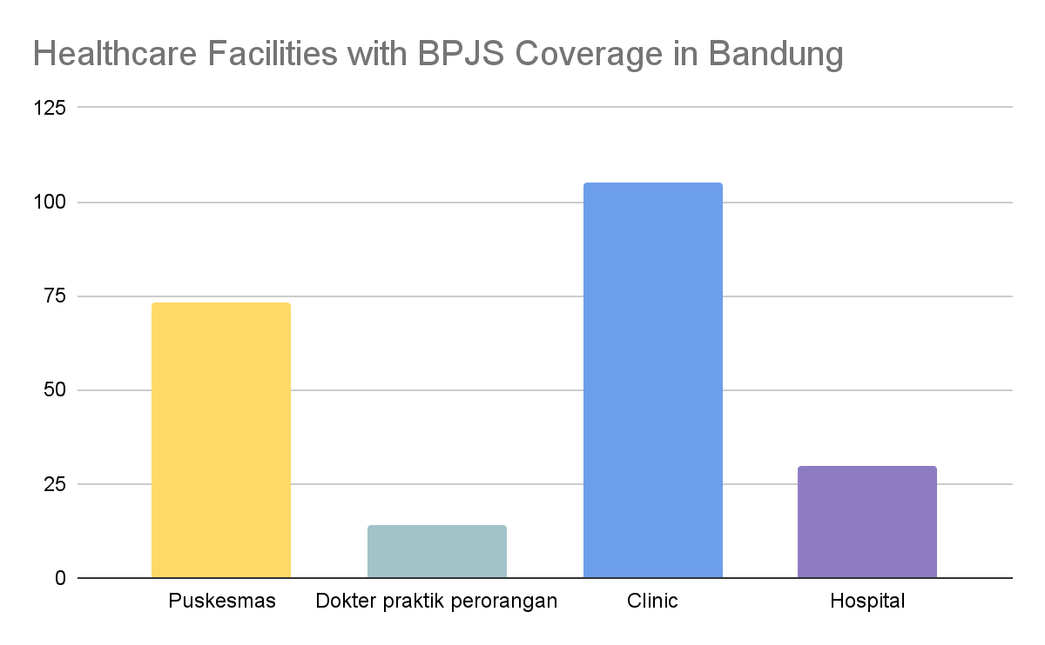
TARGET MARKET

Slide 17
Why your target market needs your solution?
Purpose-driven
Data-driven
Government reasoning
Stakeholders
General practitioners usually won’t send the patients to a specialist unless the patient specifically asked them about their skin problem. This way, they can diagnose it first by app on any skin problem, even when the patient does not think it is a problem
This solution is useful to collect more data on skin problems. Whether it is skin cancer or not. We could also asses how healthy the skin of the general public.
This solution could support the government to expand the reach of skin cancer treatment in the healthcare system
This solution to integrate with other applications are able to exponentially increase the growth of the product in the early stage

Slide 18
We use smaller and faster model than other applications

Slide 19
Commercial & Tech Roadmap
Commercial value
Tackling bigger problems in the future
Business opportunities
Benefits for long-term
Demand & Supplies
Indirect effect
Technology advantages
Science Breakthroughs
Ability to connect to platforms, users, and hospitals.
Create multi class classifier model to detect more skin cancer types
Integration with other healthcare applications
Create multi class classifier model to detect more skin cancer types
Improving Healthcare application to increase the usage of the application.
The public become more knowledgeable about skin cancer
Full user anonymity
Generating new and better dataset with the help of PERDOSKI

Slide 20
Possible pilot / trial on the next 6 months
Task | Timeline | Budget | Roles
Encrypt user data | Juli | $ 150 | Android Team, Cloud Team
Discussion on app integration with other healthcare platform | Juli - Agustus | $ 500 | All Team Members, multiple healthcare applications representative
Generate New Dataset | Juli - Oktober | $ 1500 | ML Team, Cloud Team, PERDOSKI
Integration with other healthcare Platform | September - Desember | $ 2000 | All Team Members, multiple healthcare applications team

Slide 21
Project Milestones for 2021
(to end of year)
Updating Data Encryption on the application
Updating the model of cancer detection based on the new dataset
July
October
August
December
Announcing other healthcare application as integration partners
Release the first few integrated applications with other healthcare applications

Slide 22
06 BUDGETING

Slide 23
Budgeting - Capex
Working Capital | Initial Month | Monthly
Multi app integration | 3,000,000 | 2,300,000
Patent | 1,000,000
Fixed Assets
Android App | 1,000,000
Machine Learning Model | 1,000,000
REST API | 1,000,000
Total Fixed Asset Investments | 3,000,000 | -
Total Capital Expenditures | 7,000,000 | 2,300,000

Slide 24
Budgeting - Opex
Office (Coworking Space) | 750,000
Marketing | 500,000
Server Compute Engine + Cloud SQL (GCP) | 2,300,000
Software Development | 3,300,000
Research and Data Collection | 2,000,000
Total Operating Expenditures (Per Month) | 8,850,000

Slide 25
Sustainability
Sources of Income
Efficiency Priority
Project from government: 30 Million
Grants (hibah): 5 Million
Soft Loan (pinjaman): 15 Million
Revenue from Integration: 15 Million
Rounds of Funding (pembiayaan): 75 Million
Create a better model
Generate better dataset
Reducing overhead and unnecessary costs
Reducing miscellaneous expenses

Slide 26
Expectations in 5k/10k USD Budgeting
5K Funding
10K Funding
Expected Runway: 5 months
Expected Headcount: 100+ healthcare facilities
Assets:
patent/copyright
user data
basic model
Expected Runway: 12 months
Expected Headcount: 300+ healthcare facilities
Market Positioning: High quality product with average price
Assets:
better model specific to Indonesian and multiple disease
Indonesian dataset
collaboration with other app

Slide 27
THANK YOU
Notes:
Credits : This presentation template was created by SlidesGo, including icons by Flaticon with some modifications from us.

Slide 28
SKIN CANCER DETECTION
Go-to-Market / Sustainability Proposal
Notes:
This sample serves as a guideline on what should be covered on Go-to-Market / Sustainability Proposal

Slide 29
Capstone team
Andreas Aditya Sumasta
Sipky Jaya Putra
Katherine Rayani
Pratama
Cynthia Caroline
Sherina Melinda
Alexander Tri Handoyo Wangsaputra

Slide 30
Skin Cancer
Is the most common type of cancer in the world and the third most common type of cancer in Indonesia

Slide 31
Backgrounder
What are you trying to achieve/solve?
We would like to create an application to detect those skin cancer and handle them before the cancer get worse
Is there anything been done before?
Based on our current knowledge, there are some applications like this outside of Indonesia. Other than some journals, there are no real applications for this in Indonesia

Slide 32
Intro of your capstone project
Why your capstone project is built in the first place?
We want to detect skin cancer as it is one of the most common type of cancer and help prevent it from getting worse
What are the advantages of your capstone project?
We could use this application to help the public to detect an early sign of skin cancer
General Practitioners could also use it as a base to send a patient to a specialist

Slide 34

Personas
Age Range | Profession | Roles | Attributes
15 - 45 y.o | people who often goes in outdoor | Public user | Adventurous people who like exploring nature and touring using motorcycle / bicycle
> 25 y.o | General Practitioner | Healthcare specialist | General practitioners that use this app as a first diagnosis before sending the patient to a specialist

Slide 35
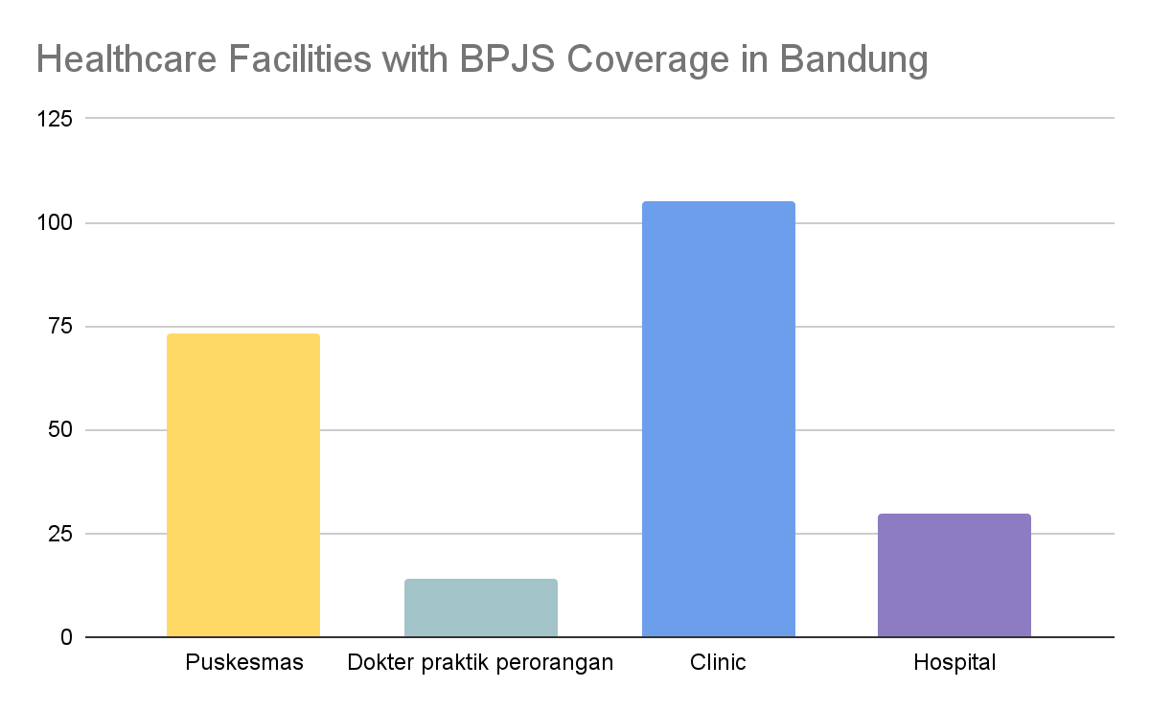
Target Market

Slide 36
Why your target market needs your solution?
Purpose-driven
General practitioners usually won’t send the patients to a specialist unless the patient specifically asked them about their skin problem. This way, they can diagnose it first by app on any skin problem, even when the patient does not think it is a problem
Data-driven
This solution is useful to collect more data on skin problems. Whether it is skin cancer or not. We could also asses how healthy the skin of the general public.
Government reasoning
This solution could support the government to expand the reach of skin cancer treatment in the healthcare system
Stakeholders related and benefitted from your solutions
This solution to integrate with other applications are able to exponentially increase the growth of the product in the early stage

Slide 37
We use smaller and faster model than other applications
Notes:
may

Slide 38
Your Roadmap
Commercial Value - Ability to connect to platforms, users, and hospitals
Business Opportunities - Integration with other healthcare applications
Demand & Supplies - Improving Healthcare Application to increase the usage of the application
Technology Advantages - Full user anonymity
Science Breakthroughs - Generating new and better dataset with the help of PERDOSKI
Tackling bigger problems in the future - Create multi class classifier model to detect more skin cancer types
Benefits for long-term - The rate of skin cancer death will go down significantly
Indirect effect - The public become more knowledgeable about skin cancer
Notes:
Aspects of these roadmap categories must be applied

Slide 39
Your Possible Pilot/Trial on the next 6 months
Task | Timeline | Budget | Roles
Encrypt user data | Juli | $ 150 | Android Team, Cloud Team
Discussion on app integration with other healthcare platform | Juli - Agustus | $ 500 | All Team Members, multiple healthcare applications representative
Generate New Dataset | Juli - Oktober | $ 1500 | ML Team, Cloud Team, PERDOSKI
Integration with other healthcare Platform | September - Desember | $ 2000 | All Team Members, multiple healthcare applications team
Notes:
Aspects of these roadmap categories must be applied

Slide 40
Project Milestones for 2021
(to end of year)
Updating Data Encryption on the application
Updating the model of cancer detection based on the new dataset
July
October
August
December
Announcing other healthcare application as integration partners
Release the first few integrated applications with other healthcare applications

Slide 41
Budgeting - 1 - USD 5k / IDR 70m
Category | Proportions (max) | Budget (max) in USD
Team Salary | 30% | $1.500 / Rp 21.000.000
Research / Operational Multiple Application Integration, Patent, Android Application Machine Learning Model, REST API Co-working space (office) Marketing Cloud Deployment & Maintenance Software Development Research and Data Collection | 90% | $4.500 / Rp 63.000.000
Notes:
See details on: https://kedaireka.id/matchingfund https://kedaireka.id/panduan/panduan_matching_fund.pdf

Slide 42
Budgeting - 2 - USD 10k / IDR 140m
Category | Proportions (max) | Budget (max) in USD
All aspects covered in Budgeting - 1 | 50% | $5.000 / Rp 70.000.000
Additional Budget for Team Salary | 20% | $2.000 / Rp 28.000.000
Additional Budget for Research/Ops | 25% | $2.500/ Rp 35.000.000
Marketing and Sales | 5% | $500 / Rp 7.000.000
Market research and competitive analysis | 5% | $500 / Rp 7.000.000
Future Development / R&D | 20% | $2.000 / Rp 28.000.000
Other Expenses (taxes, reserves) | 10% | $1.000 / Rp 14.000.000
Notes:
See details on: https://kedaireka.id/matchingfund https://kedaireka.id/panduan/panduan_matching_fund.pdf

Slide 43
Sustainability
Sustainability
Sources of Income
Efficiency Priority
Project from government: 30 Million
Grants (hibah): 5 Million
Soft Loan (pinjaman): 15 Million
Revenue from Integration: 15 Million
Rounds of Funding (pembiayaan): 75 Million
Create a better model
Generate better dataset
Reducing overhead and unnecessary costs
Reducing miscellaneous expenses
Notes:
Sample, please modify

Slide 44
Based on the 5k/10k USD Budgeting, expectations are
5K Funding
10K Funding
Expected Runway: 5 months
Expected Headcount: 100+ healthcare facilities
Assets: - patent/copyright
- user data
- basic model
Expected Runway: 12 months
Expected Headcount: 300+ healthcare facilities
Market Positioning: High quality product with average pr
Assets: - better model specific to Indonesian and able to detect multiple disease
- Indonesian dataset
- collaboration with other app
Notes:
Sample, please modify

